Slide 1
Dynamic Programming-3
Lecture-8: Longest Common Subsequence(LCS) Problem
Md. Golam Shahriar,
Lecturer, Dept. of CSE, VU

Slide 2
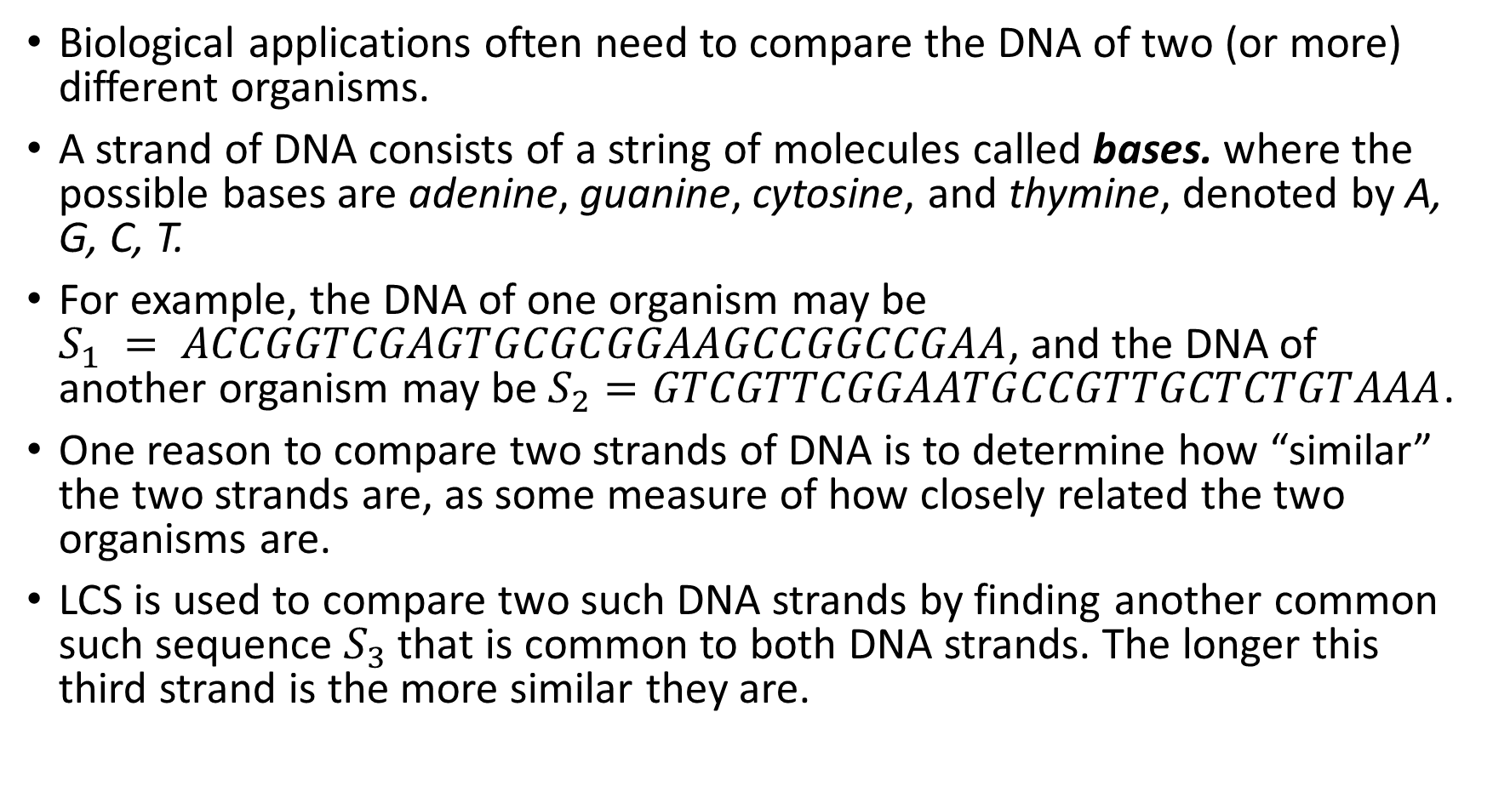
The Longest Common Subsequence Problem
Biological applications often need to compare the DNA of two (or more) different organisms.
A strand of DNA consists of a string of molecules called bases. where the possible bases are adenine, guanine, cytosine, and thymine, denoted by A, G, C, T.
For example, the DNA of one organism may be $S_{1} = ACCGGTCGAGTGCGCGGAAGCCGGCCGAA$, and the DNA of another organism may be $S_{2}=GTCGTTCGGAATGCCGTTGCTCTGTAAA$.
One reason to compare two strands of DNA is to determine how “similar” the two strands are, as some measure of how closely related the two organisms are.
LCS is used to compare two such DNA strands by finding another common such sequence $S_{3}$ that is common to both DNA strands. The longer this third strand is the more similar they are.

Slide 3
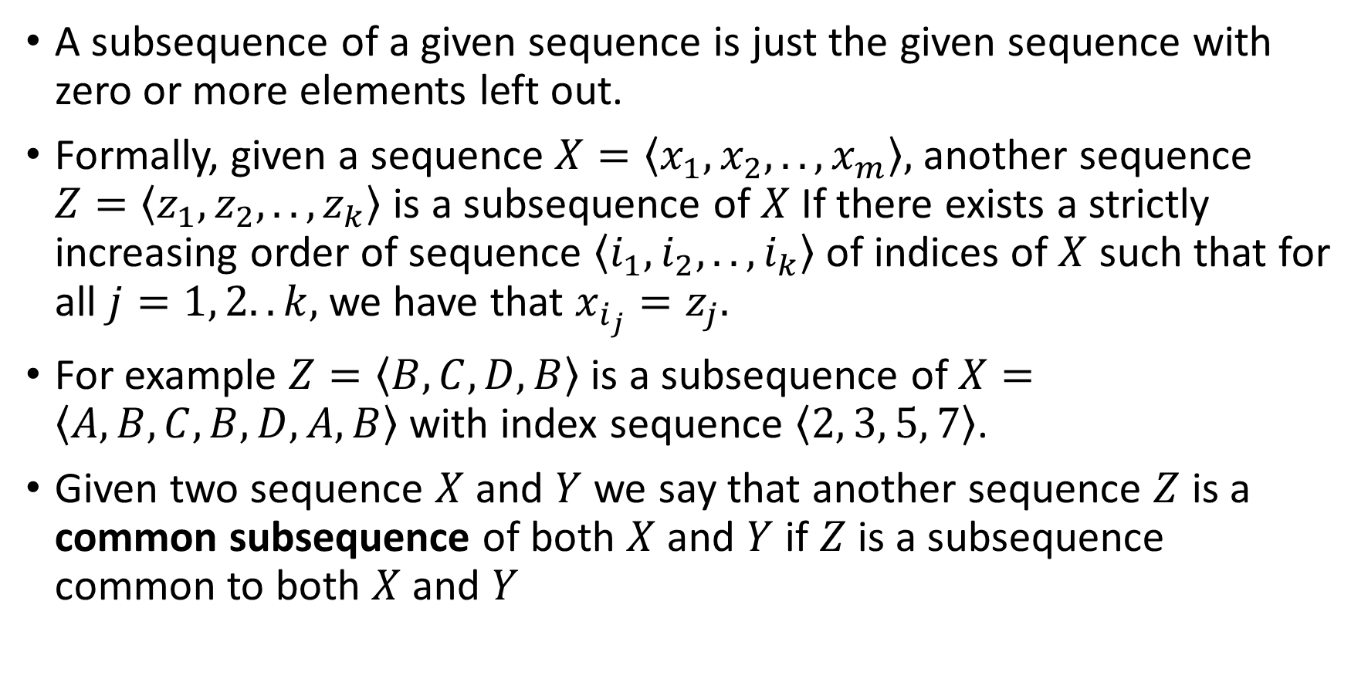
A Formal Mathematical Definition of LCS
A subsequence of a given sequence is just the given sequence with zero or more elements left out.
Formally, given a sequence $X=\left\langle x_{1}, x_{2},..,x_{m}\right\rangle ,$another sequence $Z=\left\langle z_{1},z_{2},..,z_{k}\right\rangle$ is a subsequence of $X$ If there exists a strictly increasing order of sequence $\left\langle i_{1},i_{2},..,i_{k}\right\rangle$ of indices of $X$ such that for all $j=1, 2..k,$ we have that $x_{i_{j}}=z_{j}.$
For example $Z=\left\langle B, C, D, B\right\rangle$is a subsequence of $X=\left\langle A, B, C, B, D, A, B\right\rangle$with index sequence $\left\langle 2, 3, 5, 7\right\rangle$.
Given two sequence $X$ and $Y$ we say that another sequence $Z$ is a common subsequence of both $X$ and $Y$ if $Z$ is a subsequence common to both $X$ and $Y$

Slide 4
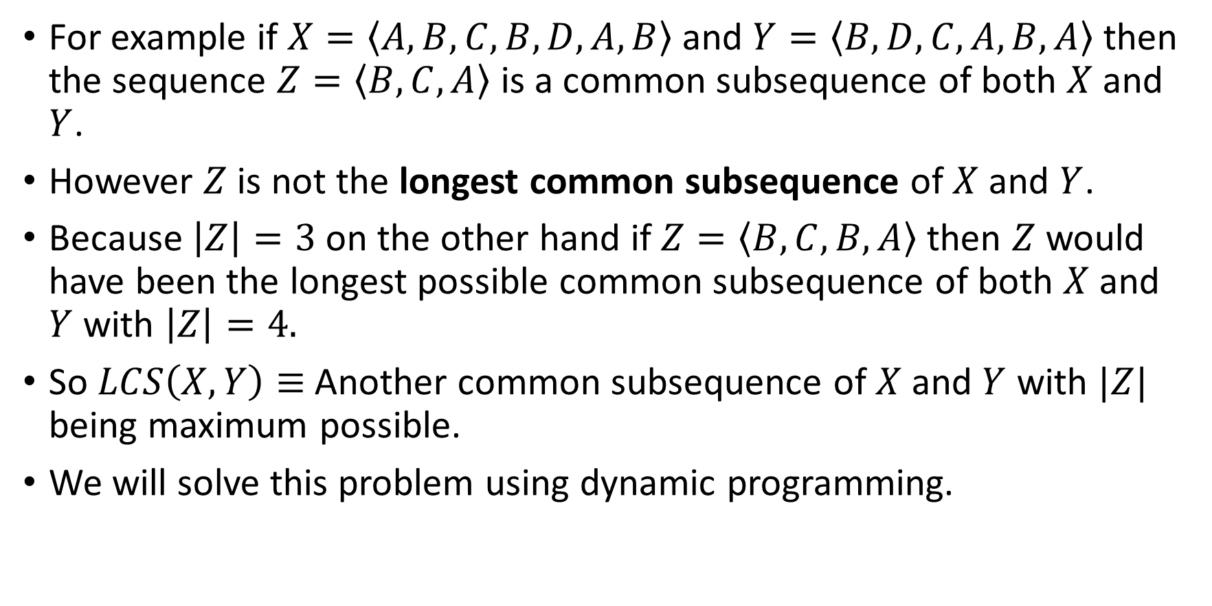
A Formal Mathematical Definition of LCS(Continued)
For example if $X=\left\langle A, B, C, B, D, A, B\right\rangle$ and $Y=\left\langle B, D, C, A, B, A\right\rangle$ then the sequence $Z=\left\langle B, C, A\right\rangle$ is a common subsequence of both $X$and $Y$.
However $Z$ is not the longest common subsequence of $X$ and $Y$.
Because $\left|Z\right|=3$ on the other hand if $Z=\left\langle B, C, B, A\right\rangle$ then $Z$ would have been the longest possible common subsequence of both $X$ and $Y$ with $\left|Z\right|=4.$
So $LCS\left(X, Y\right)≡$Another common subsequence of $X$ and $Y$ with $|Z|$ being maximum possible.
We will solve this problem using dynamic programming.

Slide 5
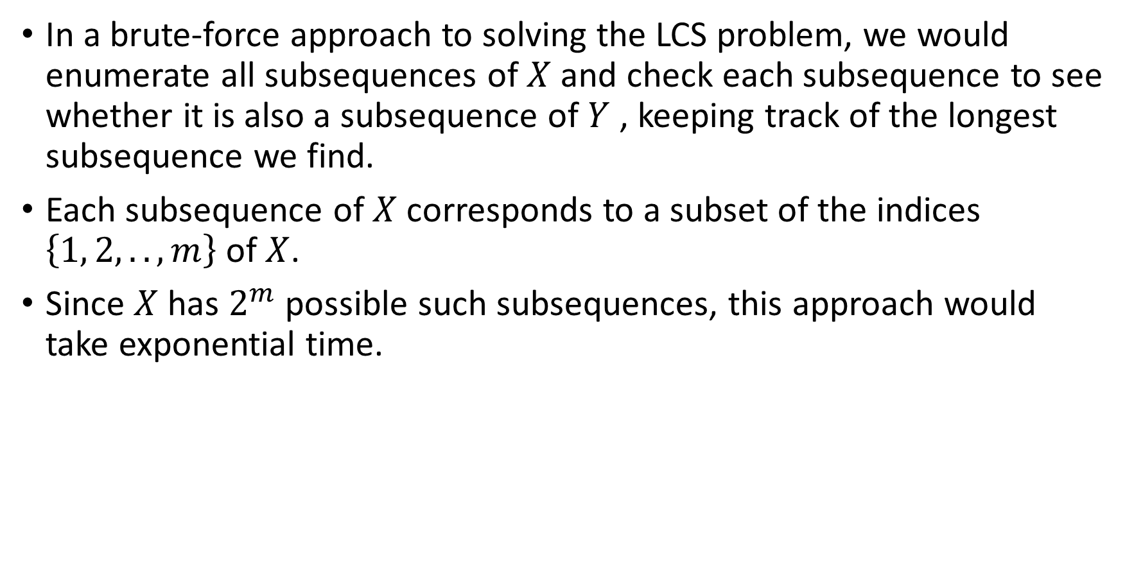
The Brute Force Approach
In a brute-force approach to solving the LCS problem, we would enumerate all subsequences of $X$ and check each subsequence to see whether it is also a subsequence of $Y$ , keeping track of the longest subsequence we find.
Each subsequence of $X$ corresponds to a subset of the indices $\left\{1, 2,..,m\right\}$of $X$.
Since $X$has $2^{m}$ possible such subsequences, this approach would take exponential time.

Slide 6
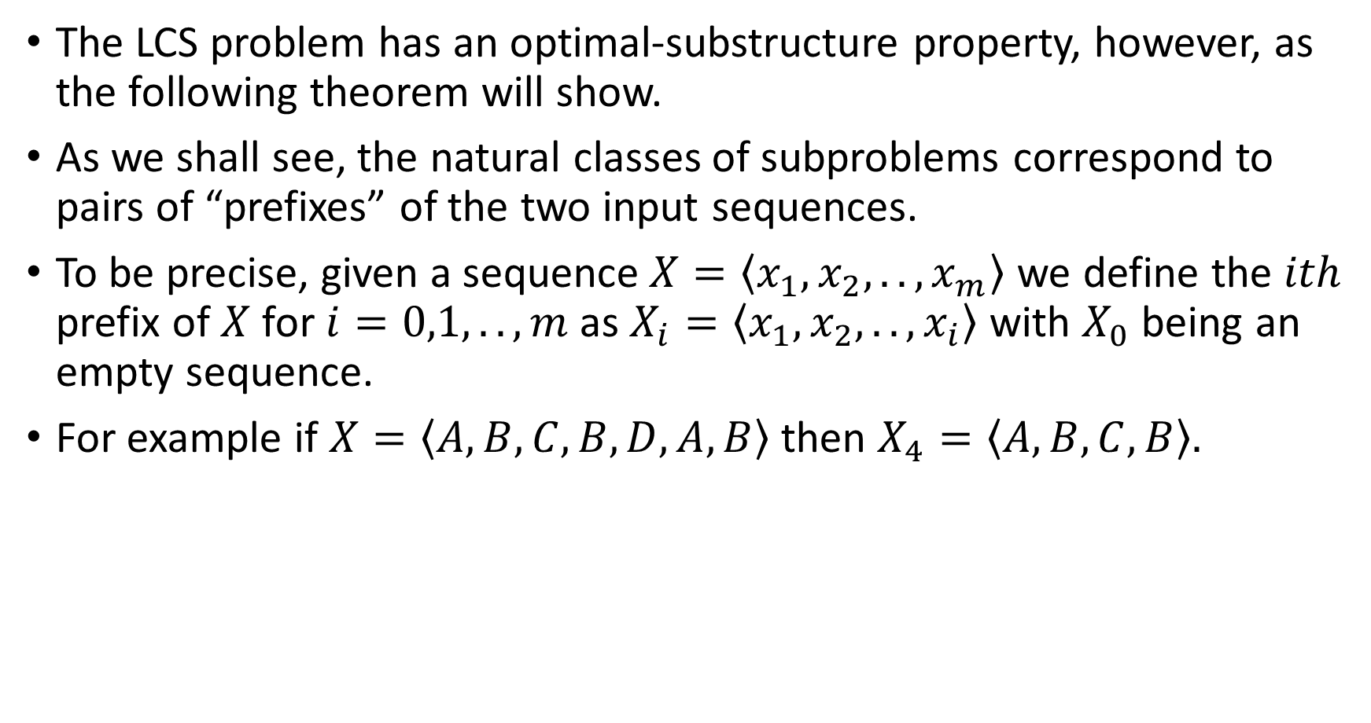
Characterizing the Optimal Substructure Property.
The LCS problem has an optimal-substructure property, however, as the following theorem will show.
As we shall see, the natural classes of subproblems correspond to pairs of “prefixes” of the two input sequences.
To be precise, given a sequence$X=\left\langle x_{1}, x_{2},..,x_{m}\right\rangle$ we define the $ith$ prefix of $X$ for $i=0,1,..,m$ as $X_{i}=\left\langle x_{1},x_{2},..,x_{i}\right\rangle$ with $X_{0}$ being an empty sequence.
For example if $X=\left\langle A,B,C,B,D,A,B\right\rangle$ then $X_{4}=\left\langle A,B,C,B\right\rangle .$

Slide 7
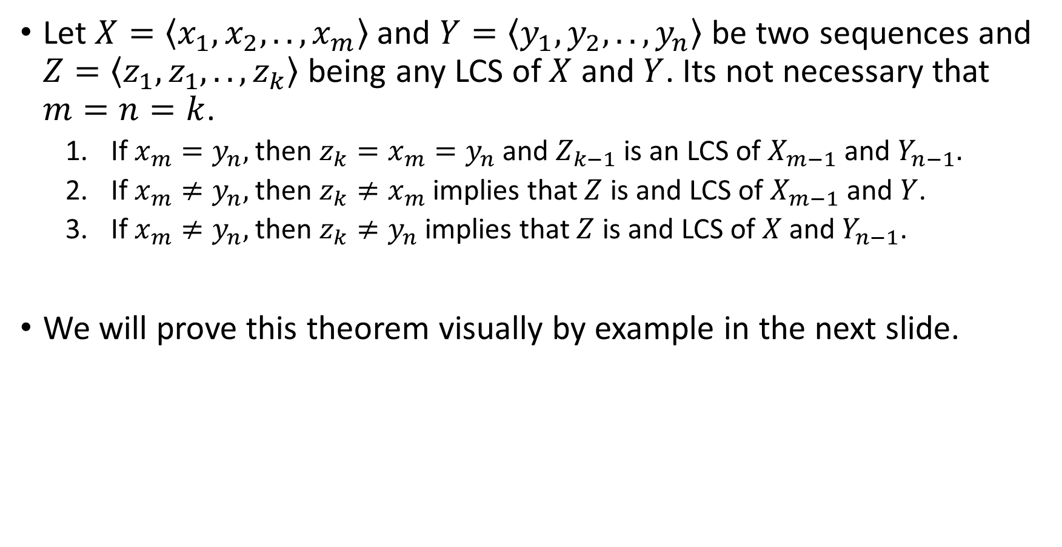
Theorem: Optimal Substructure of LCS
Let $X=\left\langle x_{1}, x_{2},..,x_{m}\right\rangle$ and $Y=\left\langle y_{1},y_{2},..,y_{n}\right\rangle$ be two sequences and $Z=\left\langle z_{1},z_{1},..,z_{k}\right\rangle$ being any LCS of $X$ and $Y$. Its not necessary that $m=n=k$.
If $x_{m}=y_{n},$ then $z_{k}=x_{m}=y_{n}$ and $Z_{k−1}$ is an LCS of $X_{m−1}$ and $Y_{n−1}.$
If $x_{m}≠y_{n},$ then $z_{k}≠x_{m}$ implies that $Z$ is and LCS of $X_{m−1}$ and $Y$.
If $x_{m}≠y_{n},$ then $z_{k}≠y_{n}$ implies that $Z$ is and LCS of $X$and $Y_{n−1}$.
We will prove this theorem visually by example in the next slide.

Slide 8
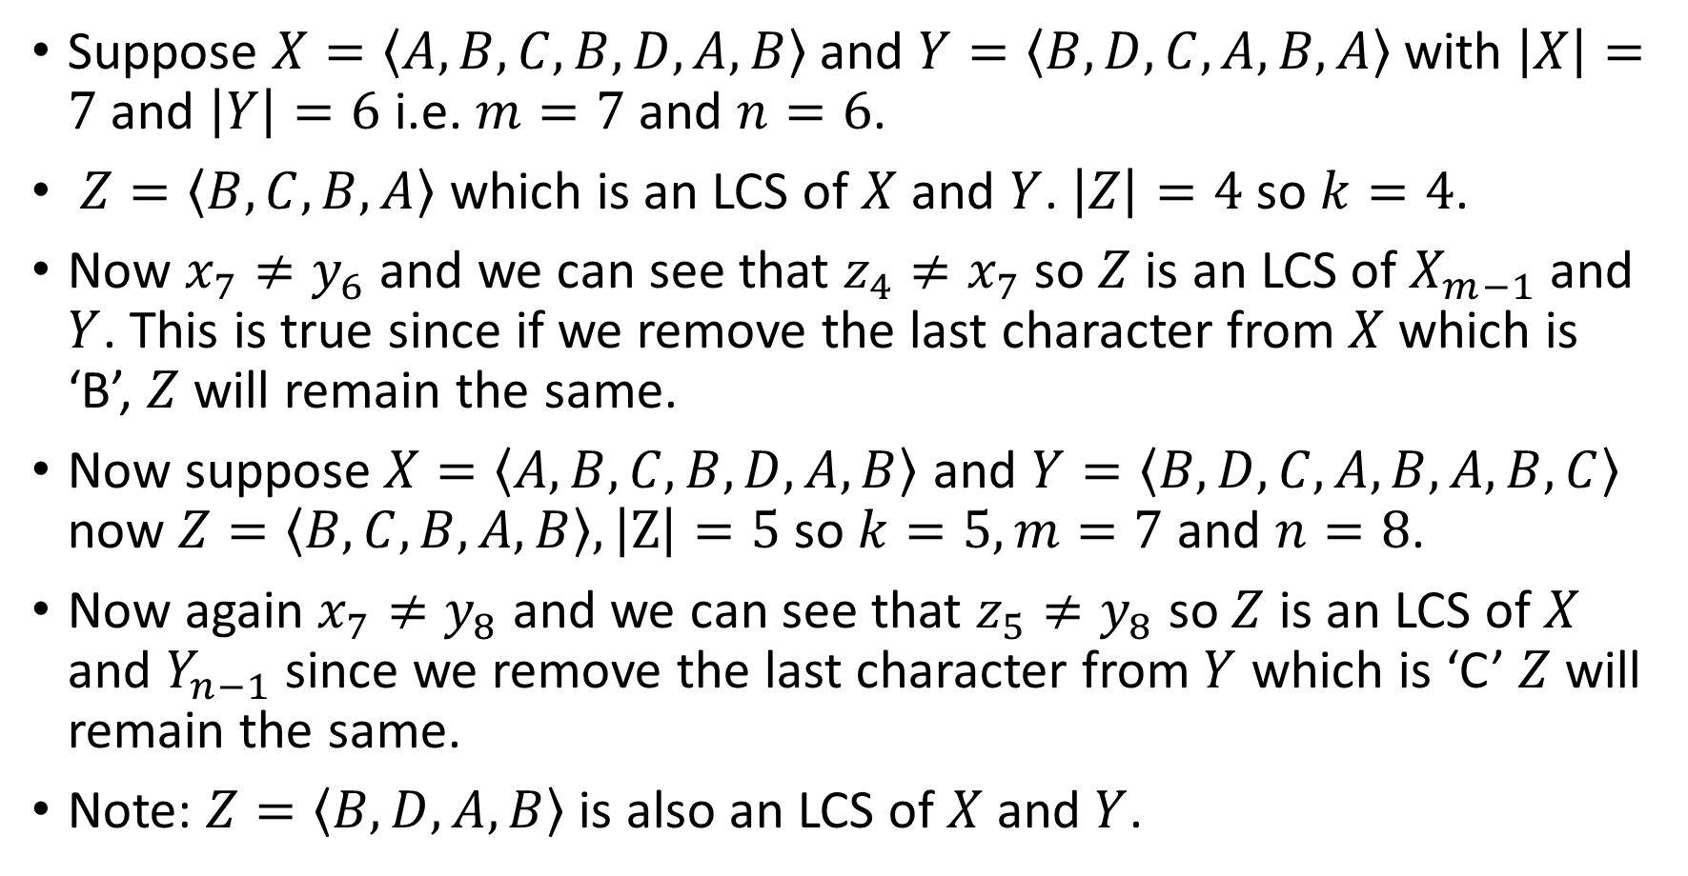
Proof of the Previous Theorem(2-3)
Suppose $X=\left\langle A, B, C, B, D, A, B\right\rangle$ and $Y=\left\langle B, D, C, A, B, A\right\rangle$ with $\left|X\right|=7$ and $\left|Y\right|=6$ i.e. $m=7$and $n=6$.
$Z=\left\langle B, C, B, A\right\rangle$ which is an LCS of $X$ and $Y$. $\left|Z\right|=4$ so $k=4$.
Now $x_{7}≠y_{6}$ and we can see that $z_{4}≠x_{7}$ so $Z$is an LCS of $X_{m−1}$ and $Y$. This is true since if we remove the last character from $X$ which is ‘B’, $Z$ will remain the same.
Now suppose$X=\left\langle A, B, C, B, D, A, B\right\rangle$ and $Y=\left\langle B, D, C, A, B, A, B, C\right\rangle$ now $Z=\left\langle B, C, B, A, B\right\rangle , \left|Z\right|=5$so $k=5, m=7$and $n=8$.
Now again $x_{7}≠y_{8}$ and we can see that $z_{5}≠y_{8}$ so $Z$ is an LCS of $X$ and $Y_{n−1}$ since we remove the last character from $Y$ which is ‘C’ $Z$will remain the same.
Note: $Z=\left\langle B,D,A,B\right\rangle$ is also an LCS of $X$ and $Y$.

Slide 9
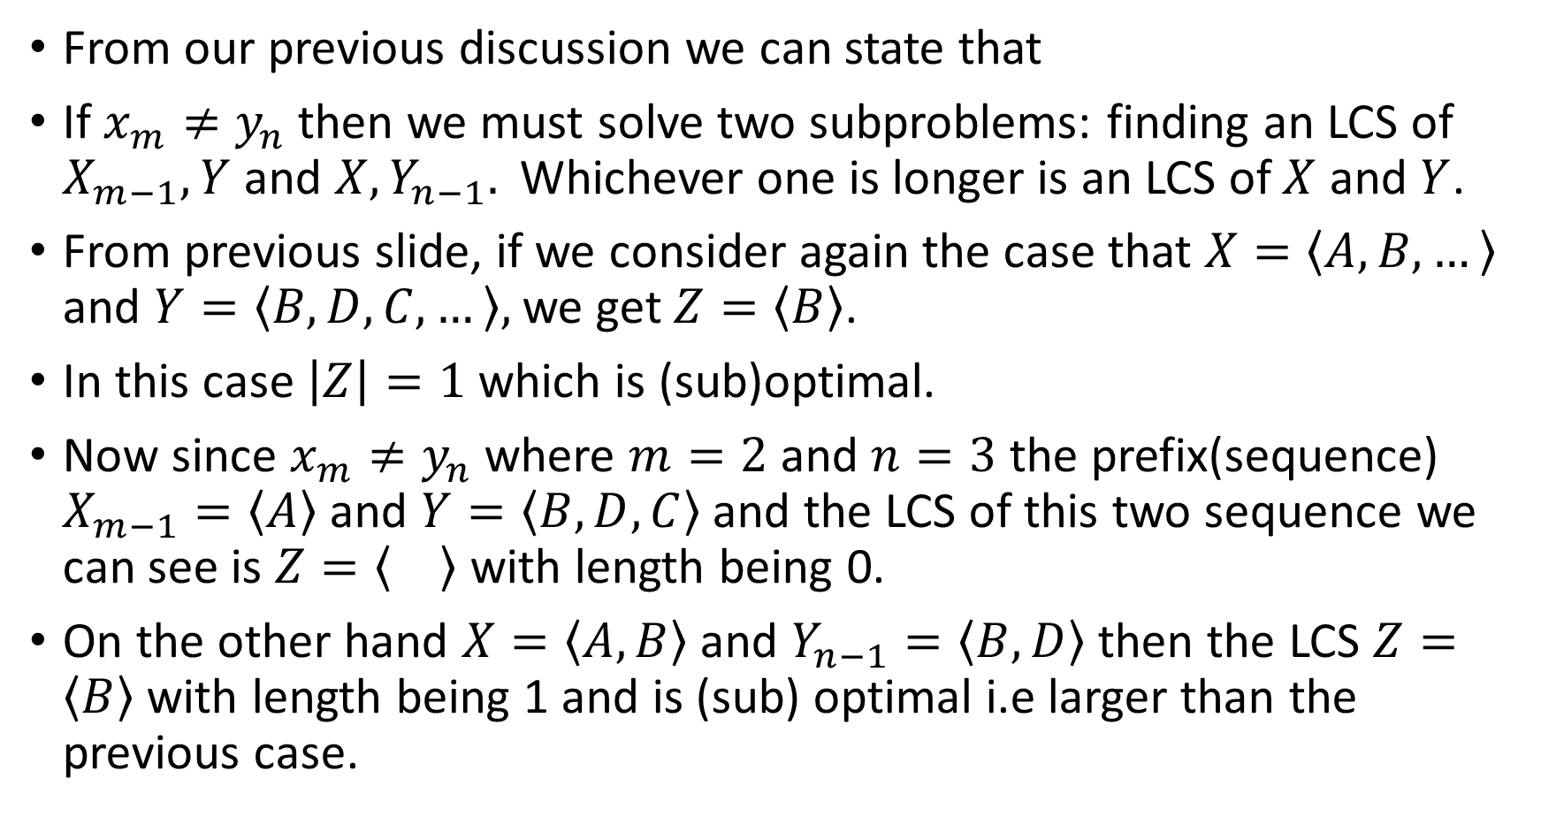
Proof of the Previous Theorem(2-3)
From our previous discussion we can state that
If $x_{m}≠y_{n}$ then we must solve two subproblems: finding an LCS of $X_{m−1}, Y$ and ${X, Y_{n−1}. }_{ }$Whichever one is longer is an LCS of $X$ and $Y$.
From previous slide, if we consider again the case that $X=\left\langle A, B,…\right\rangle$ and $Y=\left\langle B, D, C,…\right\rangle ,$ we get $Z=\left\langle B\right\rangle$.
In this case $\left|Z\right|=1$ which is (sub)optimal.
Now since $x_{m}≠y_{n}$ where $m=2$ and $n=3$ the prefix(sequence) $X_{m−1}=\left\langle A\right\rangle$ and $Y=\left\langle B,D,C\right\rangle$ and the LCS of this two sequence we can see is $Z=\left\langle \right\rangle$ with length being 0.
On the other hand $X=\left\langle A,B\right\rangle$ and $Y_{n−1}=\left\langle B,D\right\rangle$ then the LCS $Z=\left\langle B\right\rangle$ with length being 1 and is (sub) optimal i.e larger than the previous case.

Slide 10
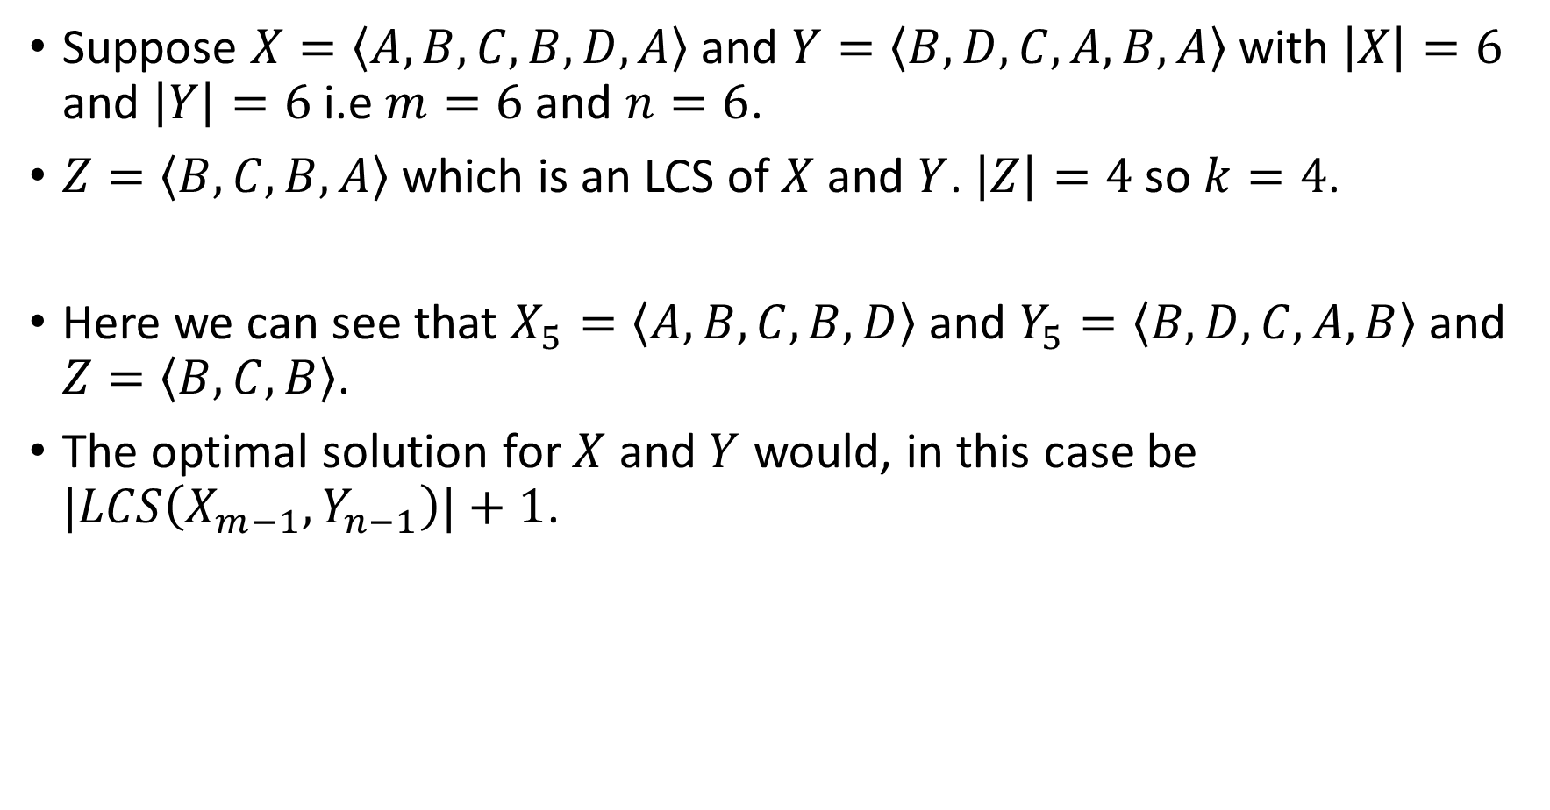
Proof of the Previous Theorem(1)
Suppose $X=\left\langle A, B, C, B, D, A\right\rangle$ and $Y=\left\langle B, D, C, A, B, A\right\rangle$ with $\left|X\right|=6$ and $\left|Y\right|=6$ i.e $m=6$and $n=6$.
$Z=\left\langle B, C, B, A\right\rangle$ which is an LCS of $X$ and $Y$. $\left|Z\right|=4$ so $k=4$.
Here we can see that $X_{5}=\left\langle A, B, C, B, D\right\rangle$ and $Y_{5}=\left\langle B,D,C,A,B\right\rangle$ and $Z=\left\langle B, C, B\right\rangle$.
The optimal solution for $X$ and $Y$ would, in this case be $|LCS\left(X_{m−1},Y_{n−1}\right)|+1$.

Slide 11
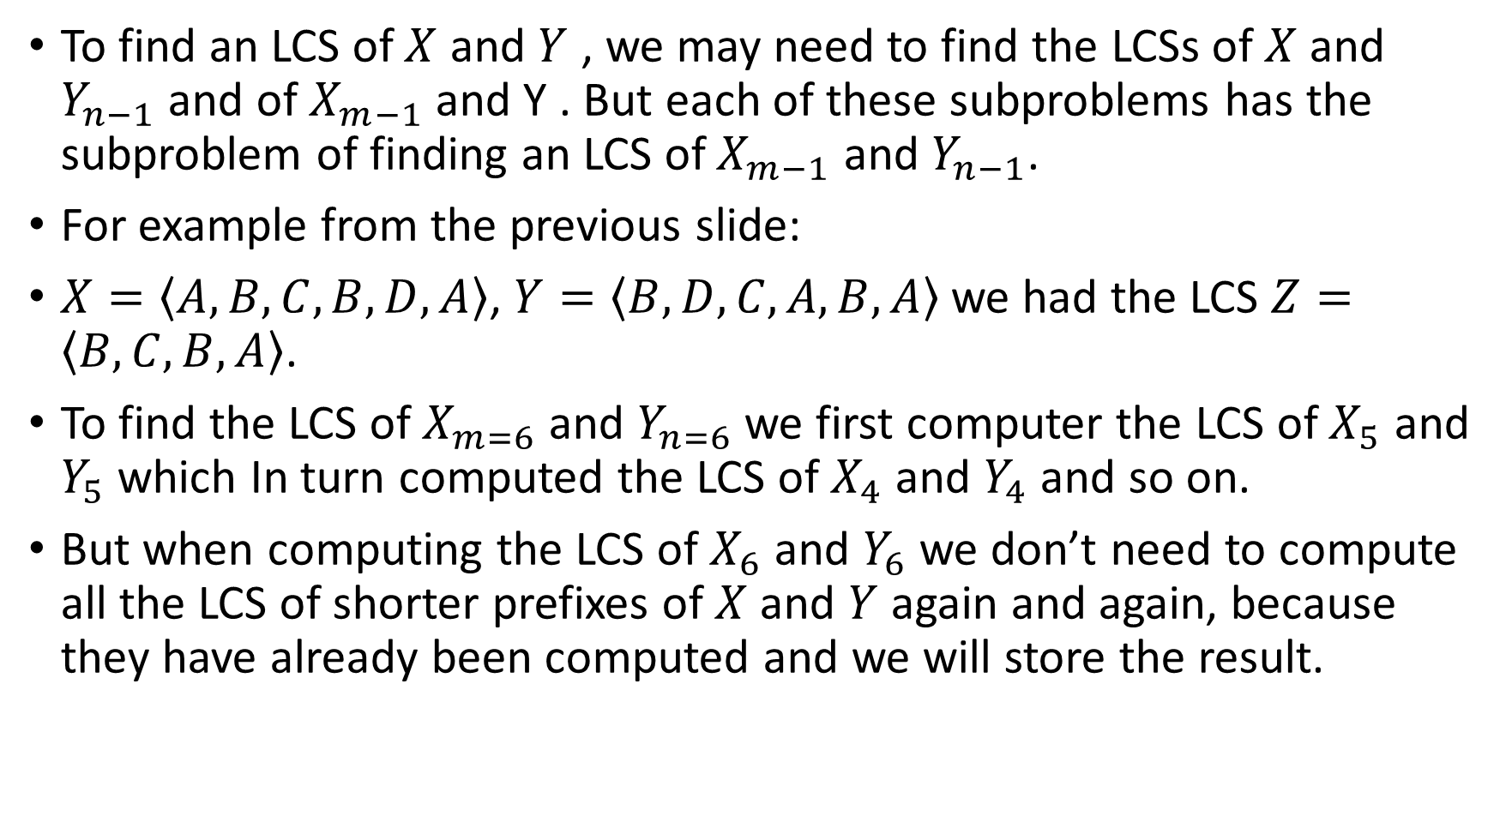
The Overlapping Substructure
To find an LCS of $X$ and $Y$ , we may need to find the LCSs of $X$ and $Y_{n−1}$ and of $X_{m−1}$ and Y . But each of these subproblems has the subproblem of finding an LCS of $X_{m−1}$ and $Y_{n−1}$.
For example from the previous slide:
$X=\left\langle A, B, C, B, D, A\right\rangle$, $Y=\left\langle B, D, C, A, B, A\right\rangle$we had the LCS $Z=\left\langle B, C, B, A\right\rangle$.
To find the LCS of $X_{m=6}$ and $Y_{n=6}$we first computer the LCS of $X_{5}$ and $Y_{5}$ which In turn computed the LCS of $X_{4}$ and $Y_{4}$ and so on.
But when computing the LCS of $X_{6}$ and $Y_{6}$ we don’t need to compute all the LCS of shorter prefixes of $X$ and $Y$ again and again, because they have already been computed and we will store the result.

Slide 12
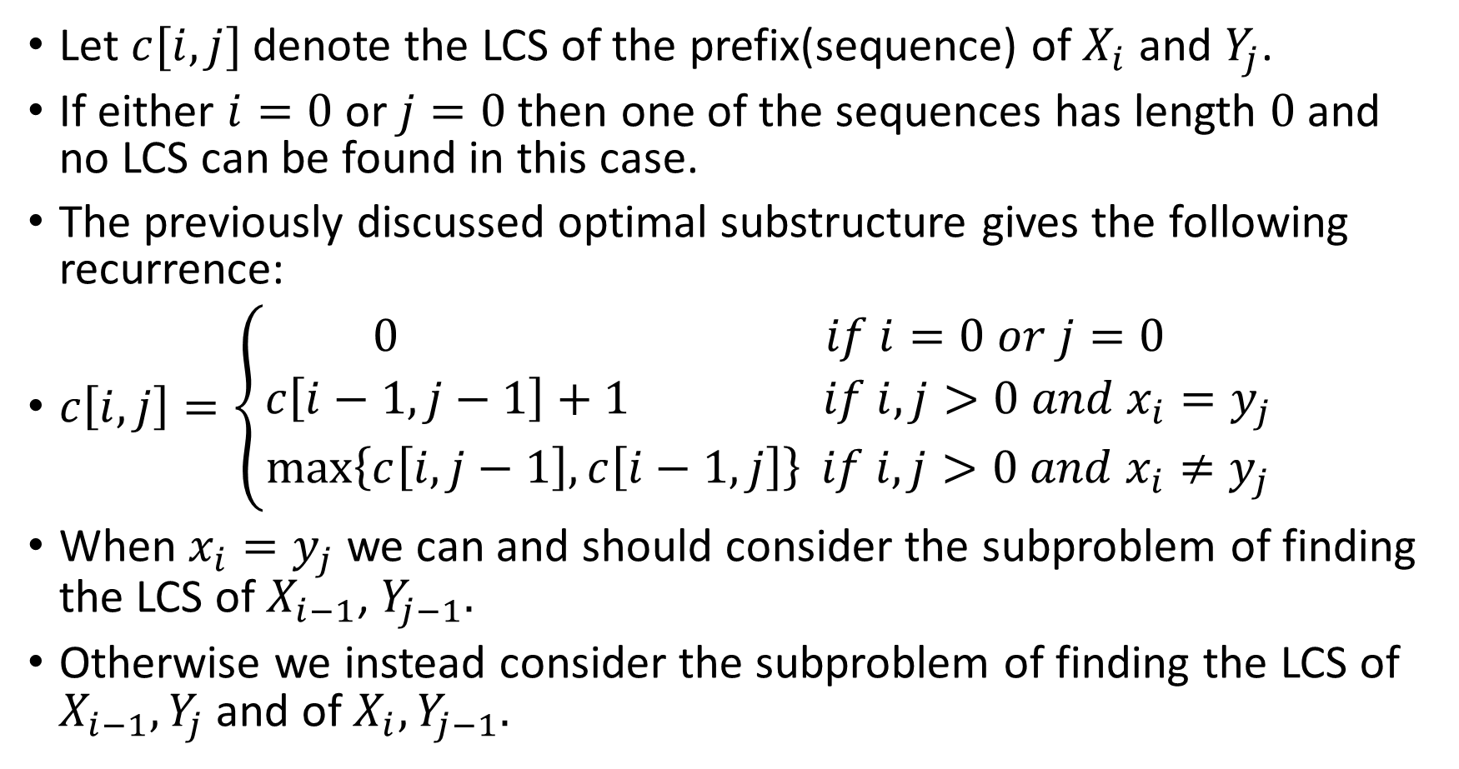
Establishing a Recurrence Relation
Let $c[i, j]$ denote the LCS of the prefix(sequence) of $X_{i}$ and $Y_{j}$.
If either $i=0$ or $j=0$ then one of the sequences has length $0$ and no LCS can be found in this case.
The previously discussed optimal substructure gives the following recurrence:
$c\left[i, j\right]=\left\{\begin{aligned}0 if i=0 or j=0 \\ c\left[i−1, j−1\right]+1 if i, j>0{ and x}_{i}=y_{j} \\ \max\left\{c\left[i, j−1\right], c\left[i−1, j\right]\right\} if i, j>0 and{ x}_{i}≠y_{j}\end{aligned}\right.$
When $x_{i}=y_{j}$ we can and should consider the subproblem of finding the LCS of $X_{i−1}$, $Y_{j−1}.$
Otherwise we instead consider the subproblem of finding the LCS of $X_{i−1}, Y_{j}$ and of $X_{i}, Y_{j−1}.$

Slide 13
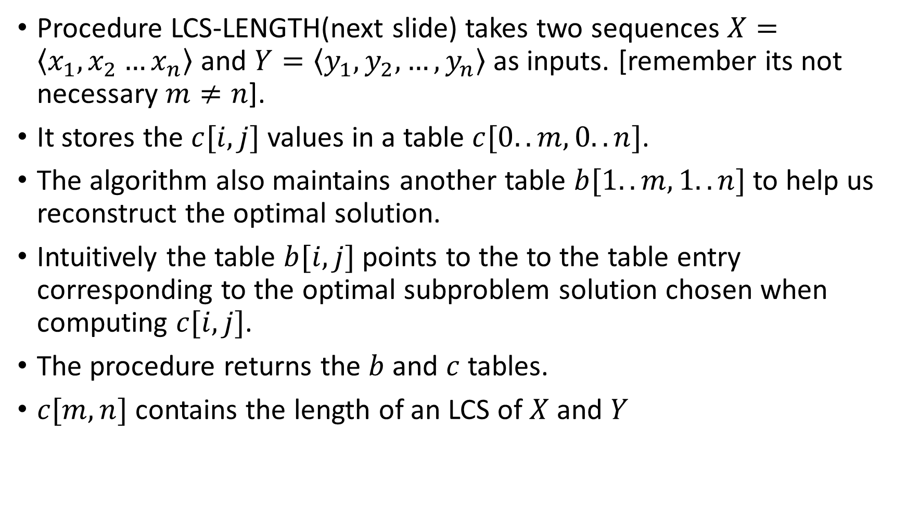
Computing the Length of LCS
Procedure LCS-LENGTH(next slide) takes two sequences $X=\left\langle x_{1},x_{2}…x_{n}\right\rangle$ and $Y=\left\langle y_{1},y_{2},…,y_{n}\right\rangle$ as inputs. [remember its not necessary $m≠n$].
It stores the $c[i,j]$ values in a table $c[0..m, 0..n]$.
The algorithm also maintains another table $b[1..m, 1..n]$ to help us reconstruct the optimal solution.
Intuitively the table $b[i, j]$ points to the to the table entry corresponding to the optimal subproblem solution chosen when computing $c[i,j]$.
The procedure returns the $b$ and $c$ tables.
$c[m,n]$ contains the length of an LCS of $X$ and $Y$

Slide 14

LCS-Length($X, Y$)
$m := X.length$
$n := Y.length$
let $b[1..m, 1..n]$ and $c[0..m, 0..n]$ be two tables.
for $i :=1$ to $m$ do
$c\left[i,0\right] := 0$
end
for $j :=0$ to $n$ do
$c\left[0, j\right] := 0$
end
for $i :=1$ to $m$ do
for $j :=1$ to $n$ do
if $x_{i}=y_{j}$ then
$c\left[i,j\right] := c[i−1, j−1] + 1$
$b\left[i,j\right] :=$UPPER-LEFT
else if $c[i−1,j]$ $≥$ $c[i,j−1]$ then
$c[i, j]$ $≔$ $c[i−1,j]$
$b\left[i,j\right] :=$ UP
else
$c[i,j] = c[i, j−1]$
$b[i,j] =$ LEFT
end
end
end
return $(c, b)$

Slide 15

The Runtime of the Previous Algorithm
The runtime is clearly $O(mn)$.

Slide 16
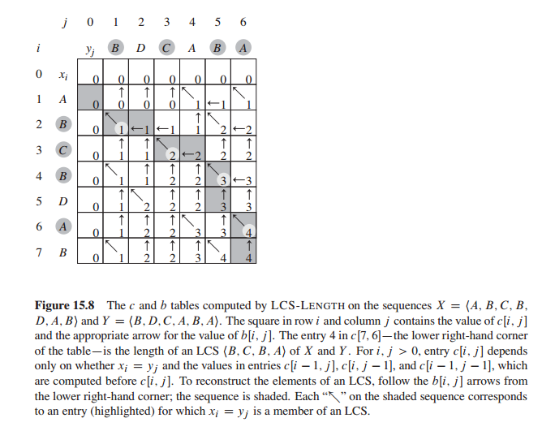

Slide 17
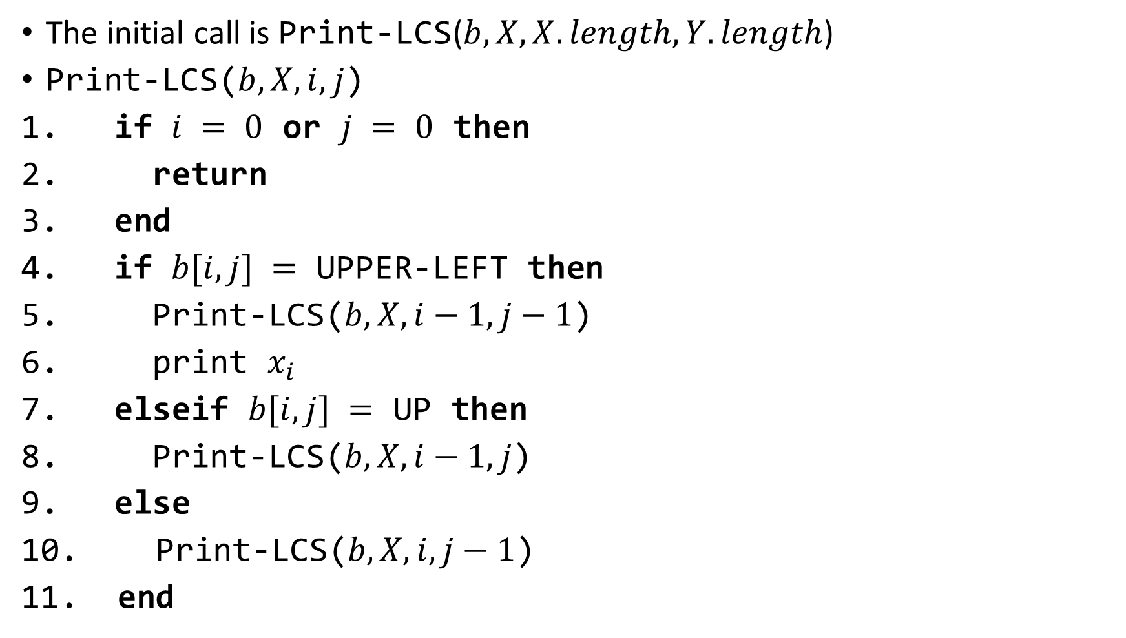
Reconstructing the Solution
The initial call is Print-LCS($b, X, X.length, Y.length$)
Print-LCS($b, X, i, j$)
if $i = 0$ or $j = 0$ then
return
end
if $b[i,j] =$ UPPER-LEFT then
Print-LCS($b,X,i−1,j−1$)
print $x_{i}$
elseif $b[i,j] =$ UP then
Print-LCS($b,X,i−1,j$)
else
Print-LCS($b,X,i,j−1$)
end

Slide 18

The Runtime of the Previous Procedure
The previous procedure takes $O(m+n)$ time since it decrements at least one of $i$ and $j$ in each recursive call.

